Slide 1
Mapping Measles Transmission with Genomics
TreeTime + phymapr on public measles (D8) sequence data
Taylor Martins — Arizona Dept. of Health Services
Emerging Pathogens practical · Molecular Epidemiology Training Series · Nov 6
All data shown is public, open-access (PathoPlexus OPEN terms).

Slide 2
What we're doing today
Two objectives — interpreting genomic output, not running code
• Objective 1 — See a measles lineage expand over time
  – A time-scaled tree of a single genotype (D8) shows when a lineage took off and how it diversified.
• Objective 2 — Detect geographic spread signals
  – A transmission map turns the dated tree into state-to-state (and international) movement you can read.
• The tool chain
  – Aligned FASTA + metadata → IQ-TREE (tree) → TreeTime (molecular clock) → phymapr (map).
• Your job in the practical
  – Read the tree and the map, judge how much to trust them, and say what that means operationally.

Slide 3
From lab to bioinformatics to epi
Lab
Bioinformatics
Epi interpretation
• Specimens sequenced at the Utah Public Health Laboratory (UPHL).
• We work from the resulting whole-genome consensus sequences.
• We cannot correct for collection or submission bias.
• Filter + pick representative sequences (next slide).
• IQ-TREE builds the maximum-likelihood tree.
• TreeTime fits the molecular clock and dates the tree.
• phymapr reconstructs locations and draws the map.
• Is the lineage expanding? Where is it moving?
• How much should I trust the dates? (clock r²)
• Are these real transmission links or just imports?
• What does that tell me operationally?

Slide 4
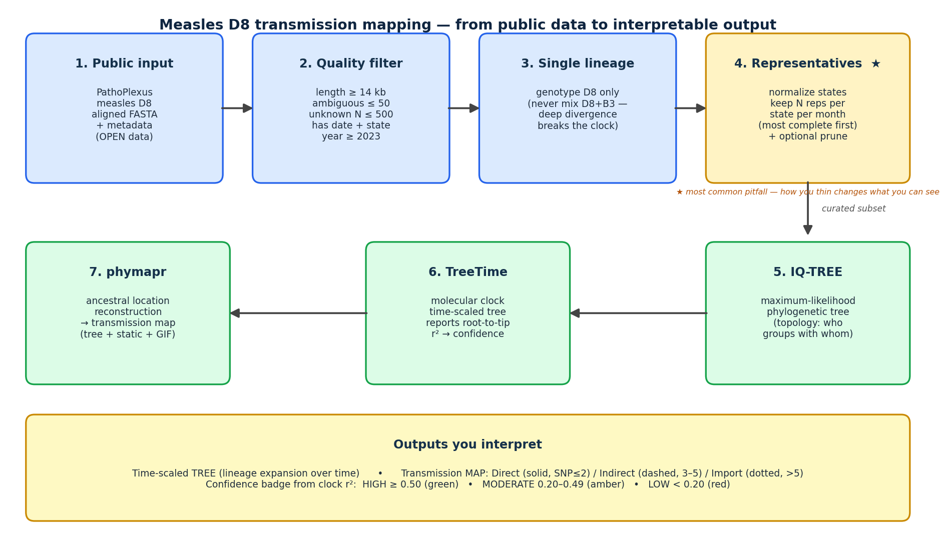
How we filter the data
From ~30,000 public sequences down to a readable, single-lineage subset

Slide 5
Getting the tools
Everything is open-source and on GitHub
Installation difficulty: Medium–High
• phymapr — github.com/ADHS-Taylor/phymapr
  – R package: time-scaled tree, ancestral reconstruction, static + animated maps. Pathogen-agnostic — tunable for any organism.
• phymap-workflow — github.com/ADHS-Taylor/phymap-workflow
  – One command from aligned FASTA + metadata to tree + map (IQ-TREE → TreeTime → phymapr).
• Reproducible environment
  – A single conda environment file installs the whole stack in one step.
• Data
  – Download an aligned D8 FASTA + metadata from pathoplexus.org (OPEN data).
  – Cite per pathoplexus.org/about/citation and follow the OPEN data-use terms.
  – No special access needed.

Slide 6
Reading the output
Two things to check on every map
1. Pathway type (by SNP distance)
• Direct — solid line (≤ 2 SNPs): genetically tight, plausible local transmission.
• Indirect — dashed (3–5 SNPs): related, with likely unsampled intermediates.
• Import / Distant — dotted (> 5 SNPs): appeared from elsewhere; too far for a local chain.
• These cutoffs are pathogen-specific — tuned here for measles; phymapr lets you set them for any pathogen.
2. Confidence badge (from clock r²)
clock r² = ≥ 0.50 — HIGH — dates trustworthy
r² = how clock-like the data is: do later samples sit
proportionally further from the root? High r² → trust the
dates. Low r² (clonal, tightly related genomes) → read the
topology, not the timing. (Cutoffs are our practical teaching
convention — see references, next slide.)
clock r² = 0.20–0.49 — MODERATE — dates indicative
clock r² = < 0.20 — LOW — don't trust dates

Slide 7
Why we read the clock this way
Root-to-tip temporal signal — selected references
• Rambaut A, Lam TT, Carvalho LM, Pybus OG. Exploring the temporal structure of heterochronous sequences using TempEst. Virus Evolution. 2016;2(1):vew007.
• Duchêne S, Featherstone L, Haritopoulou-Sinanidou M, Rambaut A, Lemey P, Baele G. Bayesian evaluation of temporal signal in measurably evolving populations. Mol Biol Evol. 2020;37(11):3363–3379.
• Featherstone LA, Rambaut A, Duchêne S, Wirth W. Clockor2: inferring global and local strict molecular clocks using root-to-tip regression. Syst Biol. 2024;73(4):623–628.
Note on our HIGH / MODERATE / LOW bands:
Temporal signal is a continuum, and the field recommends formal tests (e.g., date-randomization) rather than a single r² cutoff.
Our three bands are a practical reading convention for this session — a quick cue for 'how much should I trust the dates,'
not a formal threshold from these papers. The published Texas measles study used Clockor2 root-to-tip r² the same way, as a diagnostic.

Slide 8
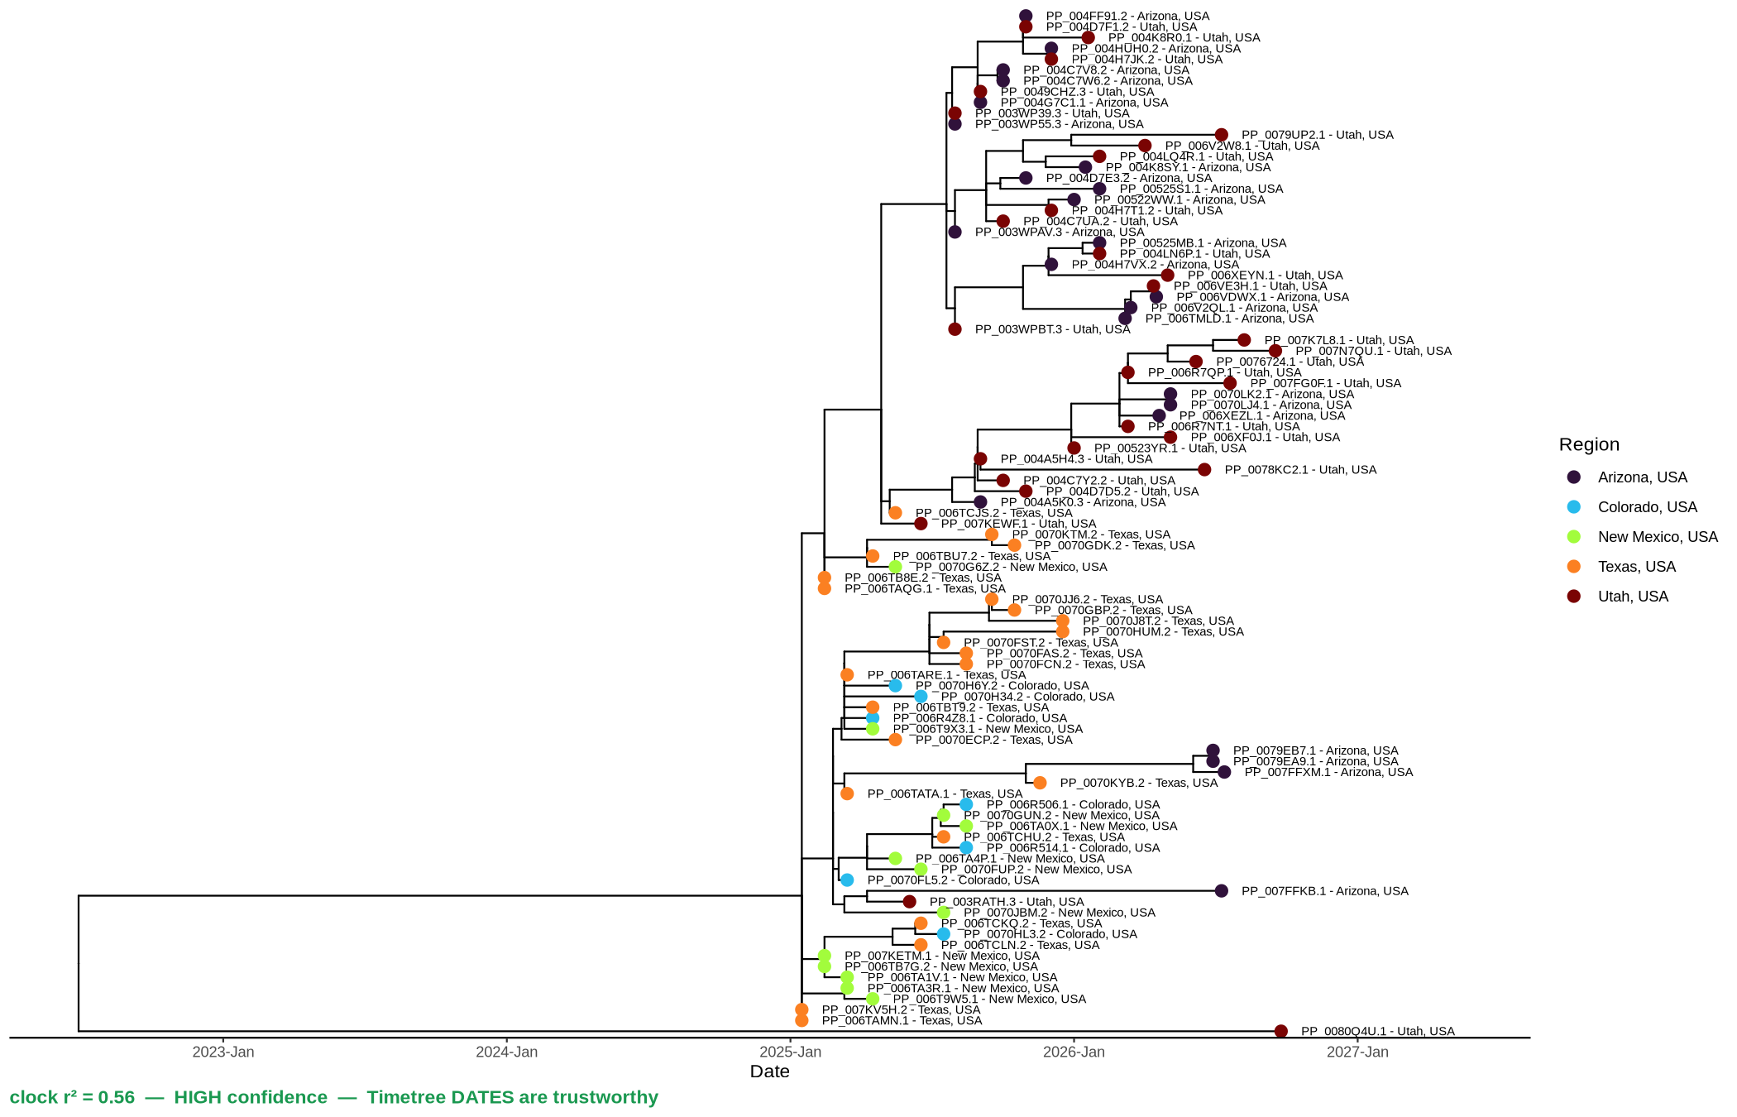
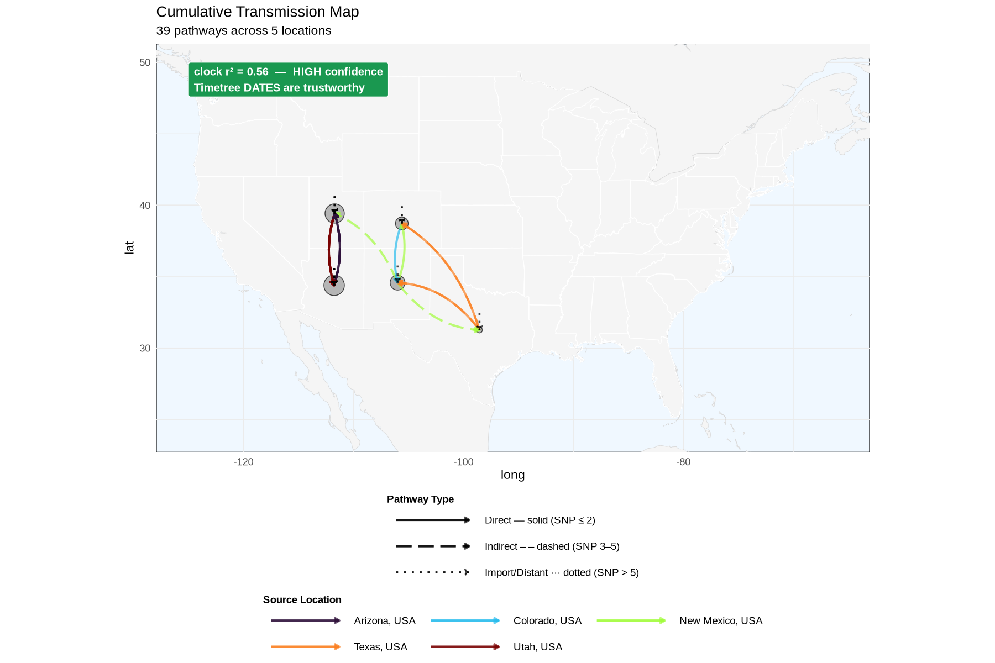
Southwest cluster — the clearest regional story
Breakdown: southwest · measles D8 · public PathoPlexus data
TREE (time-scaled)
MAP (transmission)
clock r² = 0.56 — HIGH
• Connected 2025 outbreak across AZ, UT, NM, TX, CO.
• Tree: near-identical genomes interleave across neighboring states → genuine regional spread.
• Map: a dense knot of direct + indirect arcs confined to the Southwest.
• Clock is clean (r² 0.56) → the dates are usable. This matches the known epi picture.

Slide 9
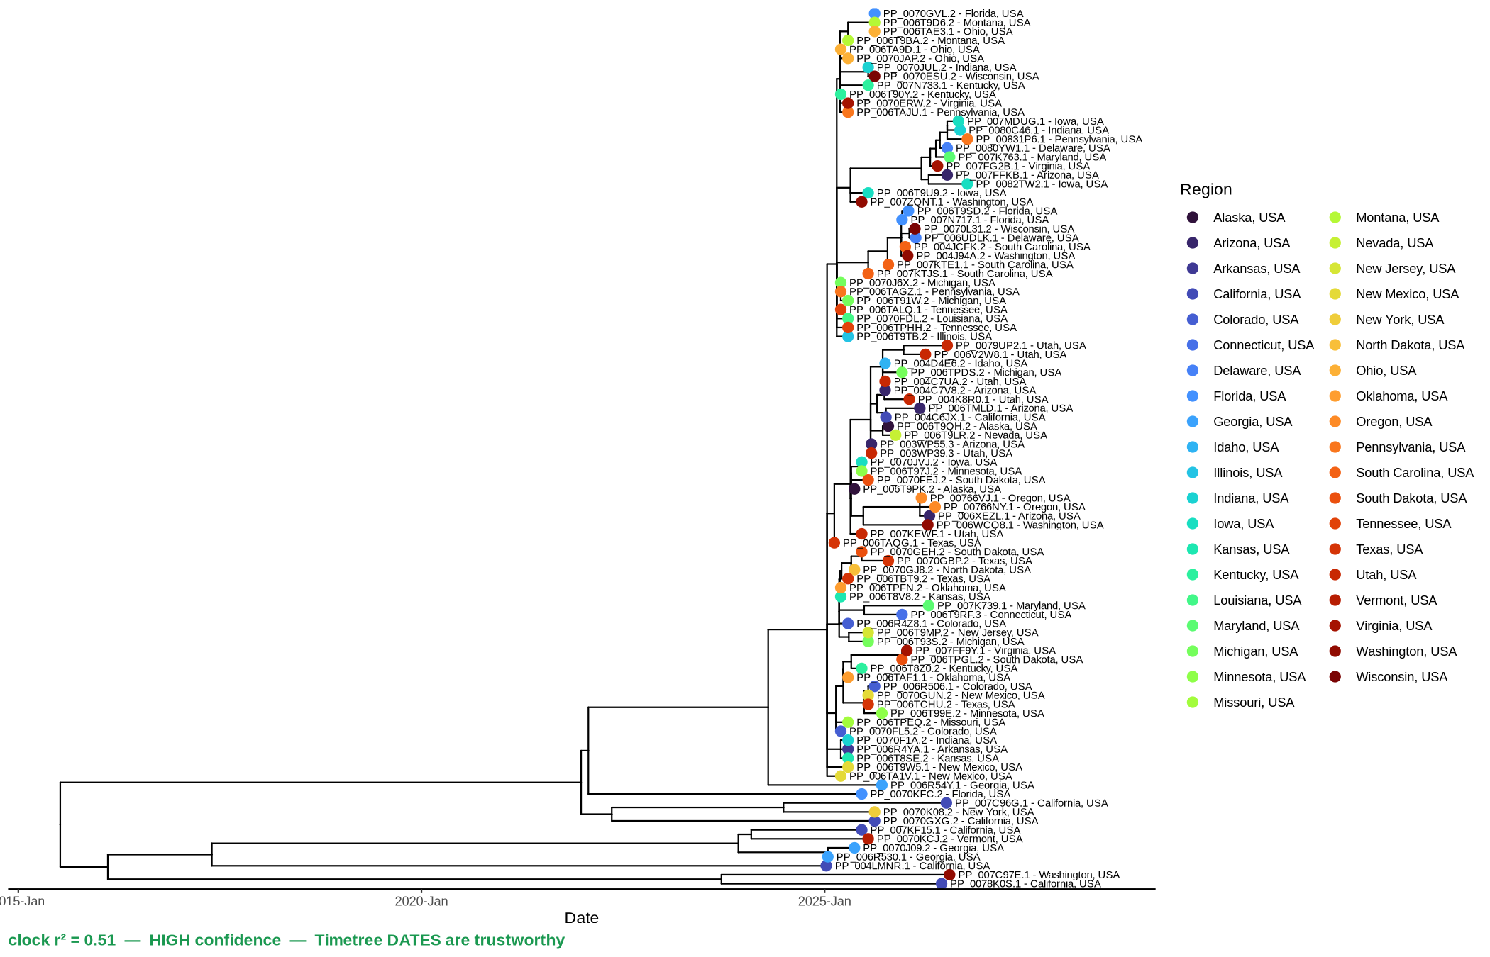
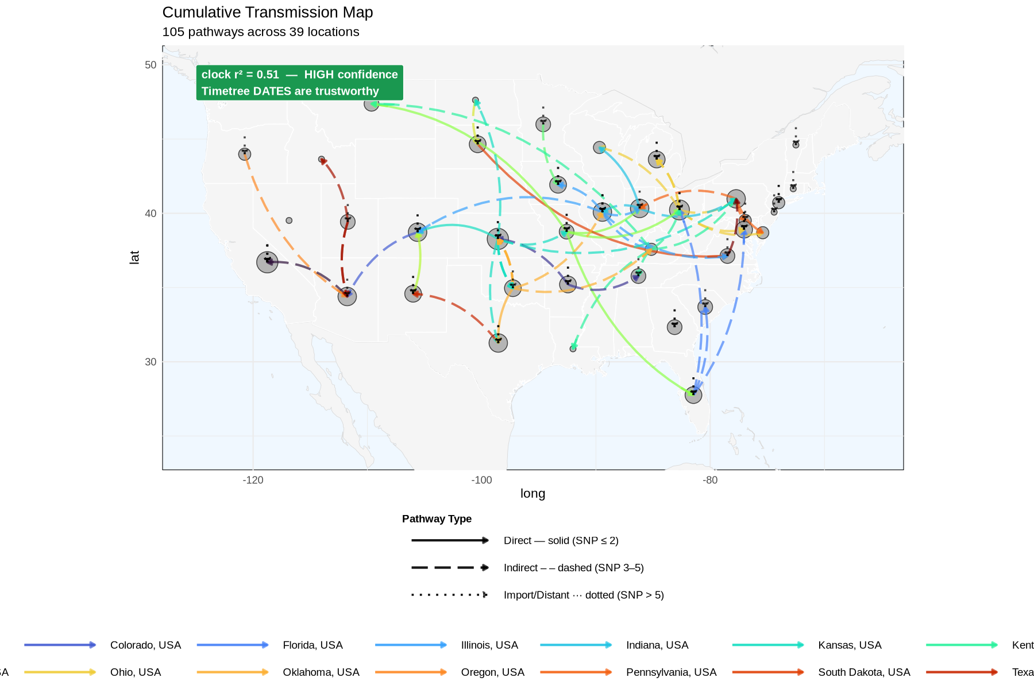
National picture — mostly imports
Breakdown: all_states_reps · measles D8 · public PathoPlexus data
TREE (time-scaled)
MAP (transmission)
clock r² = 0.51 — HIGH
• One or a few representatives per state, ~40 states; a genuinely national view with a clean clock (r² 0.51).
• Most arcs read as imports. Thinning to one rep per state is part of why — but 'just sample more' is not a simple fix:
  • adding many near-identical genomes can make pathways HARDER to resolve, not easier (direct vs indirect blurs).
  • Net: this is a reasonably confident national snapshot; the import-heavy read reflects both real spread and sampling design (surveillance).

Slide 10
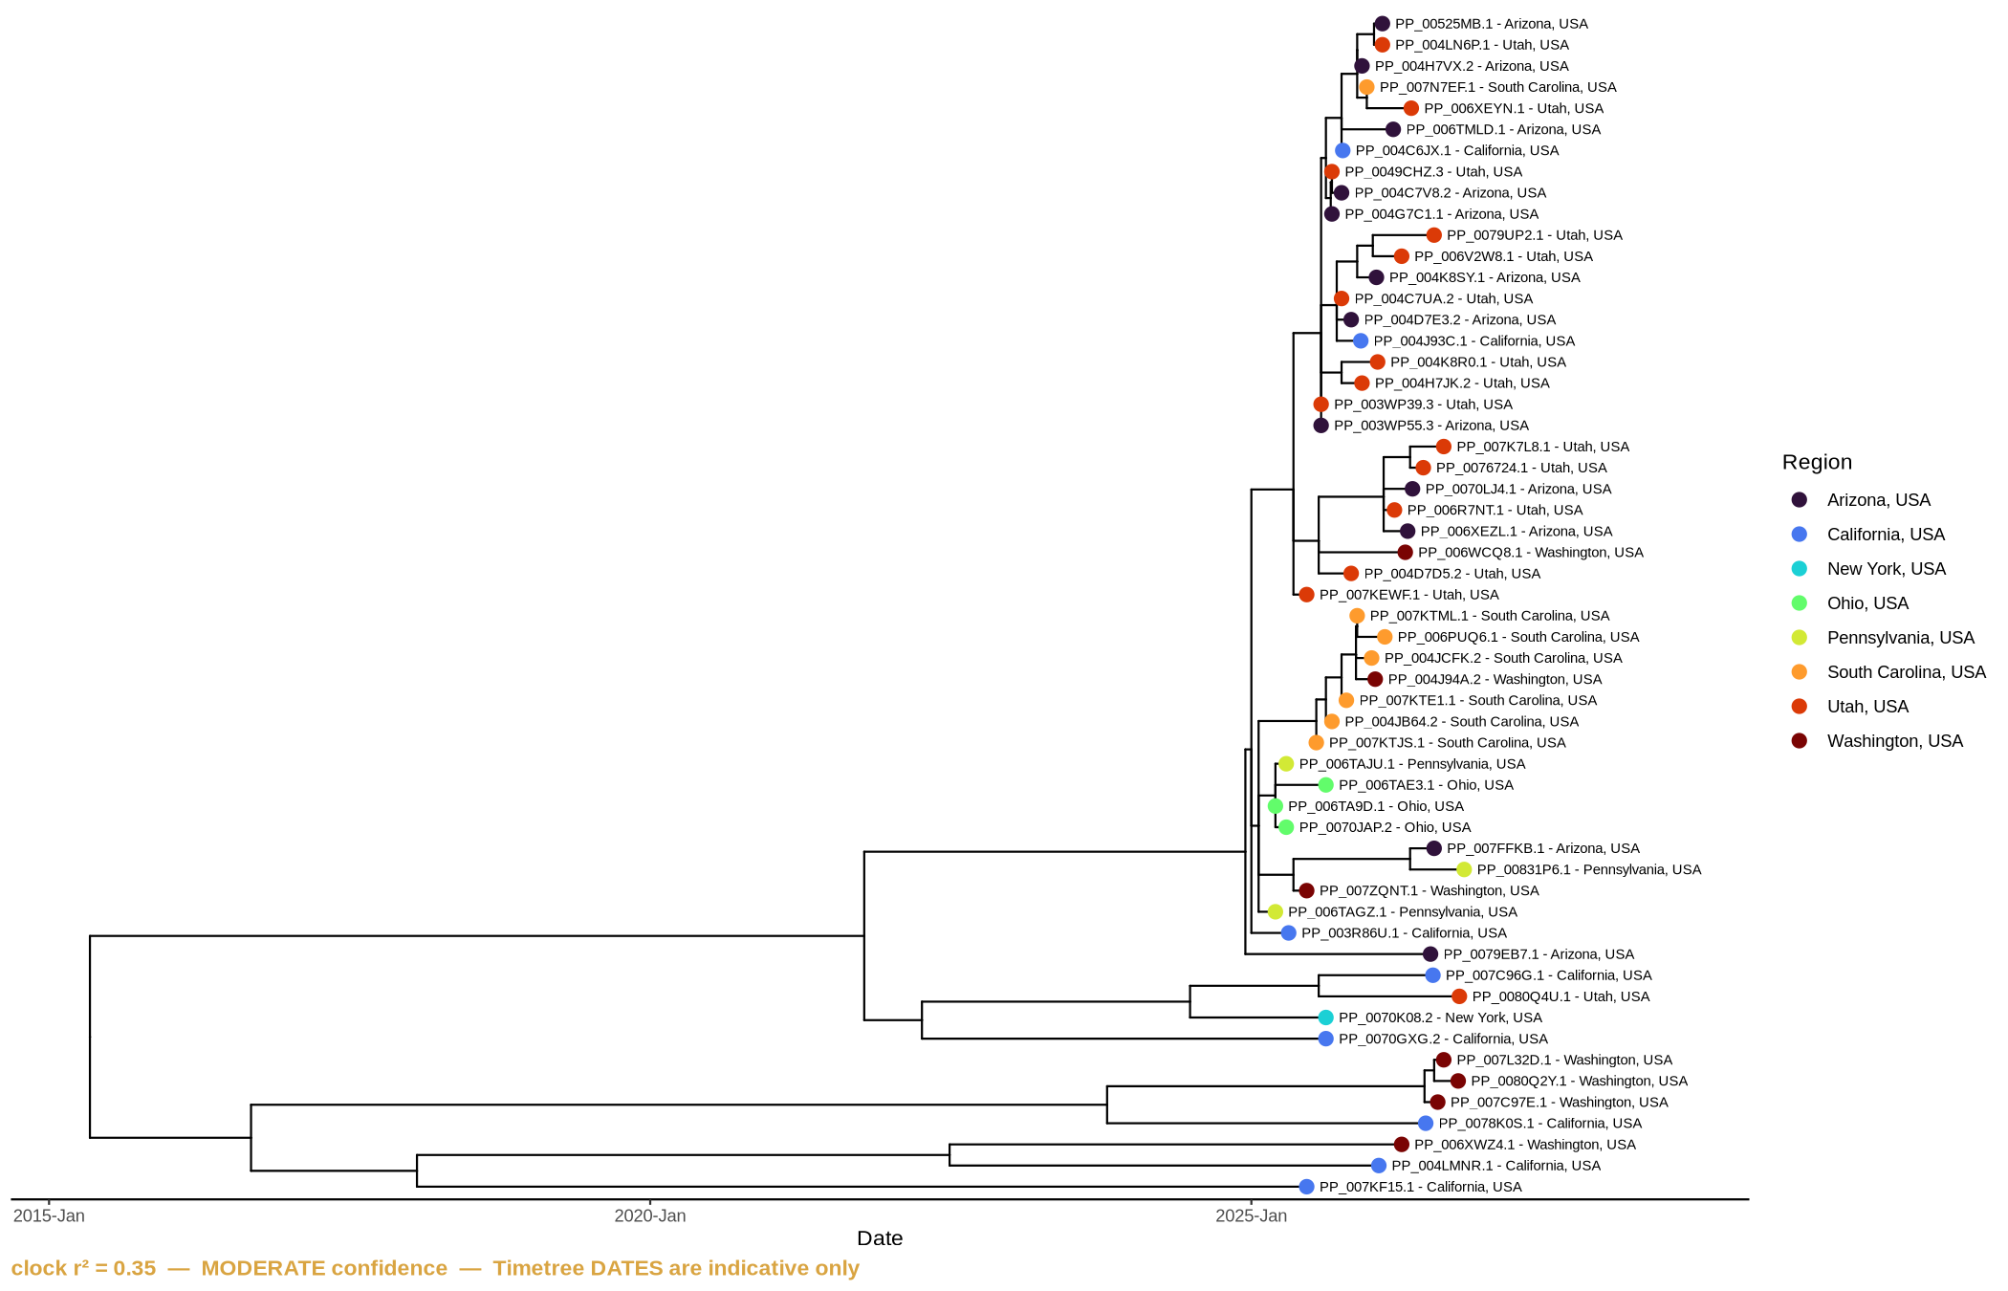
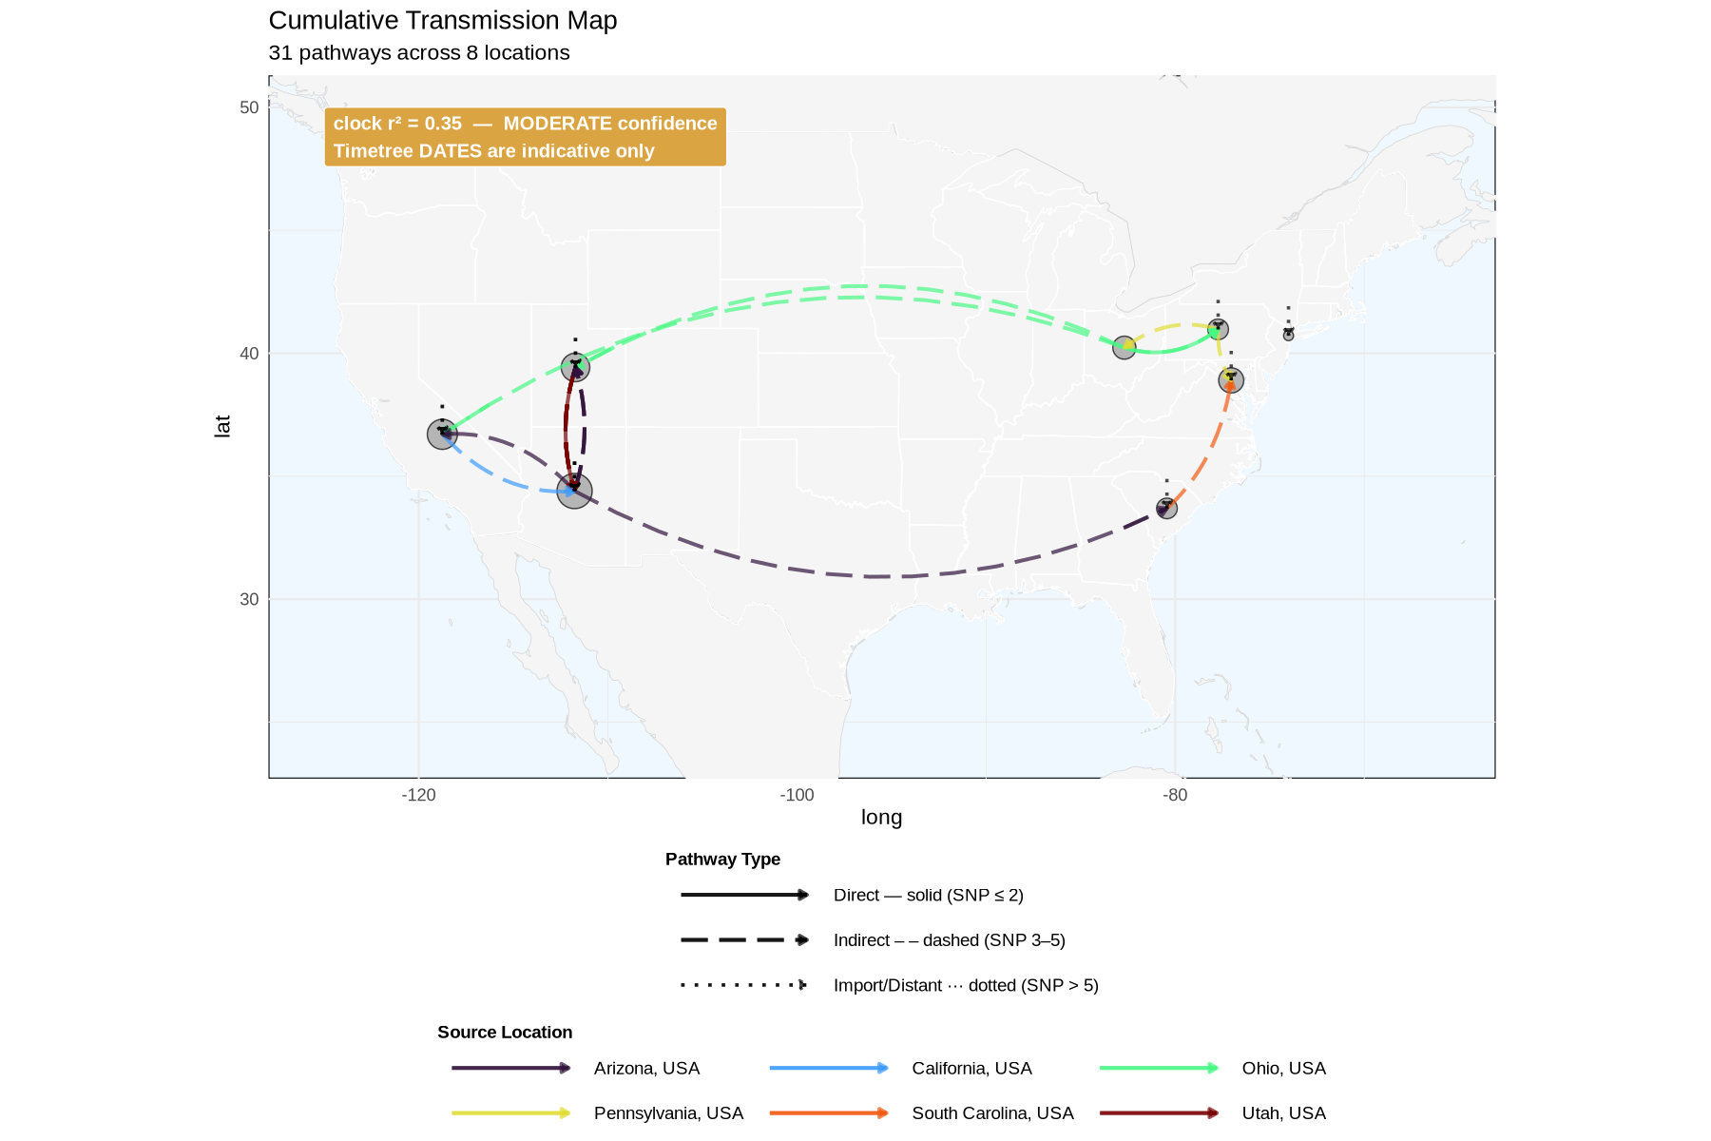
West vs East — co-circulating D8, no surveillance in between
Breakdown: east_v_west · measles D8 · public PathoPlexus data
TREE (time-scaled)
MAP (transmission)
clock r² = 0.35 — MODERATE
• Deliberate West (UT/AZ/CA/WA) vs East (SC/OH/PA/NY) split — co-circulating D8 within the US.
• Map is dominated by long-range indirect/import arcs: this is what it looks like when we lack sampling in between.
• Clock is weaker (r² 0.35) → treat dates as approximate ranges.
• Note the shape: coast-to-coast US here mirrors the trans-Atlantic international picture (next) — a natural comparison.

Slide 11
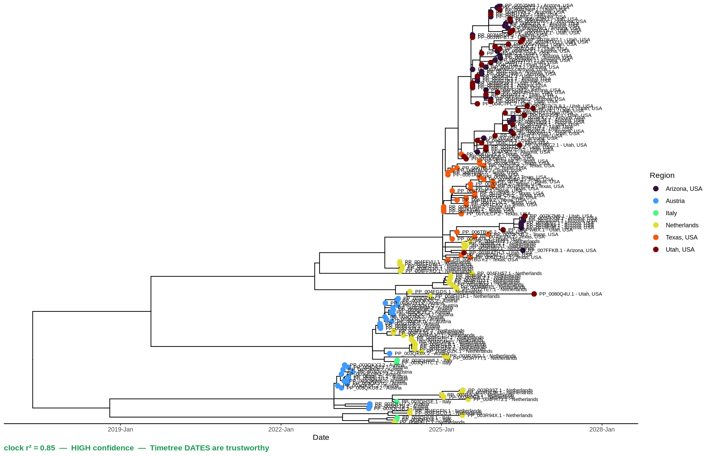
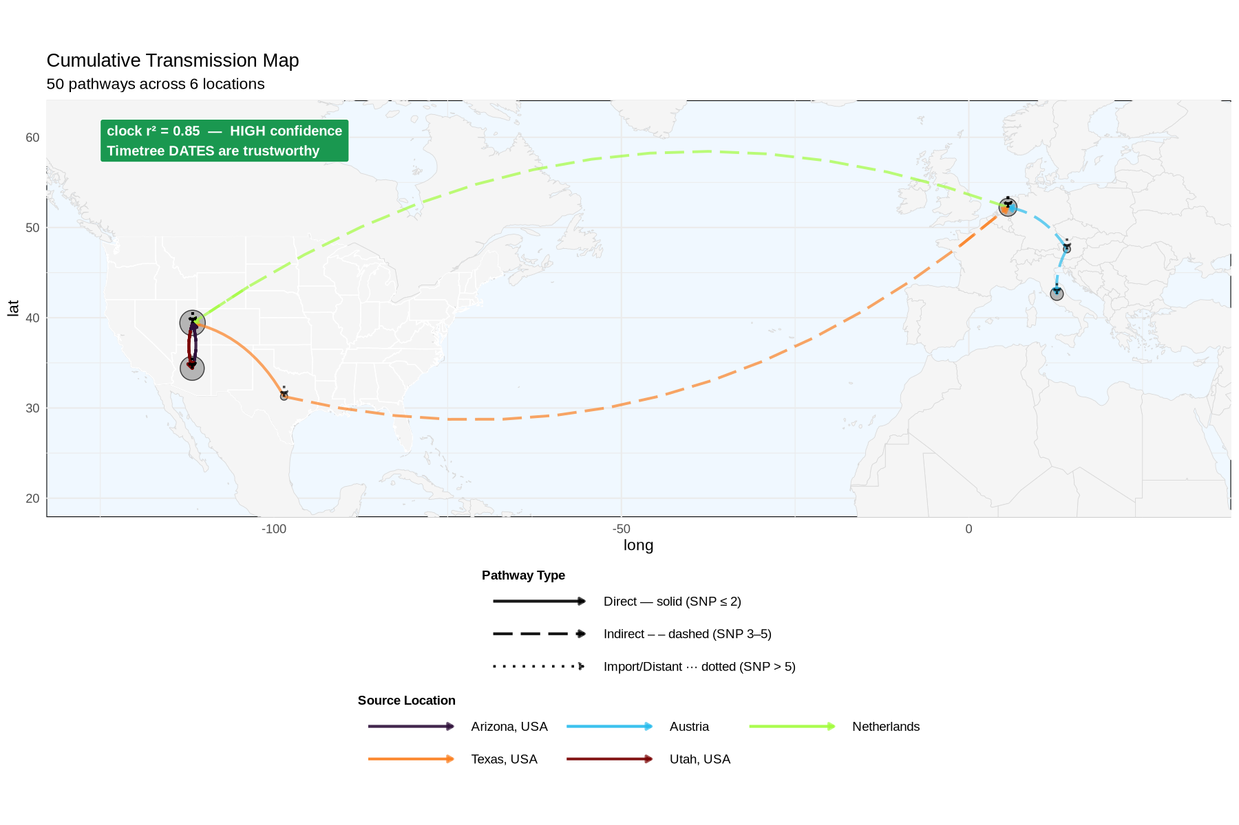
International — importation origin (interpret with care)
Breakdown: international · measles D8 · public PathoPlexus data
TREE (time-scaled)
MAP (transmission)
clock r² = 0.85 — HIGH
• European genomes (Italy 2024, Netherlands, Austria) + US focal states (TX/UT/AZ).
• Clock is the strongest in the set (r² 0.85) — breadth across continents + 2024→2025 adds signal.
• Ties to the published finding that Texas clustered with Netherlands genomes.
• Directionality still looks odd DESPITE the high r² — because of the surveillance gap, not a clock problem.
• Read as 'related, importation-consistent', not a proven source-and-direction.

Slide 12
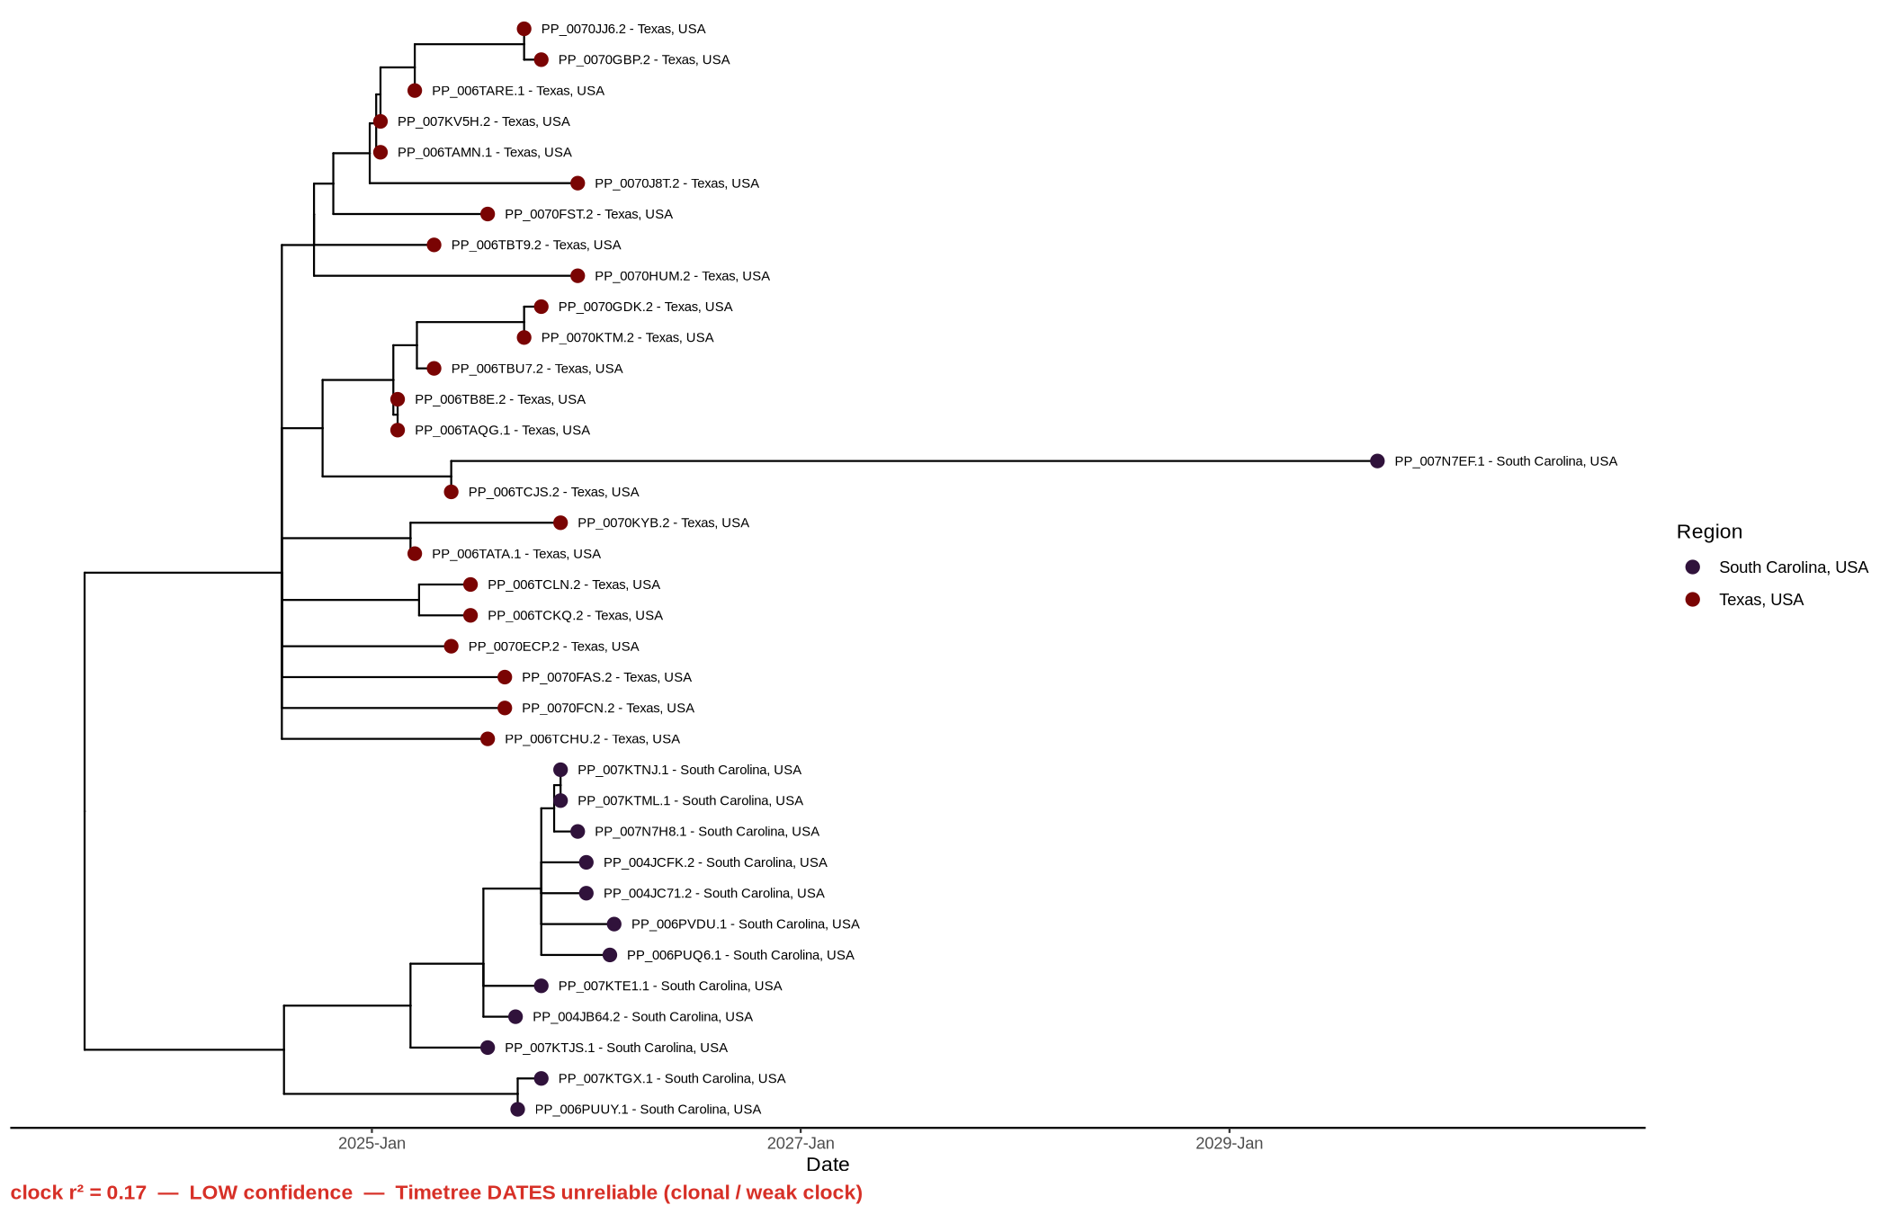
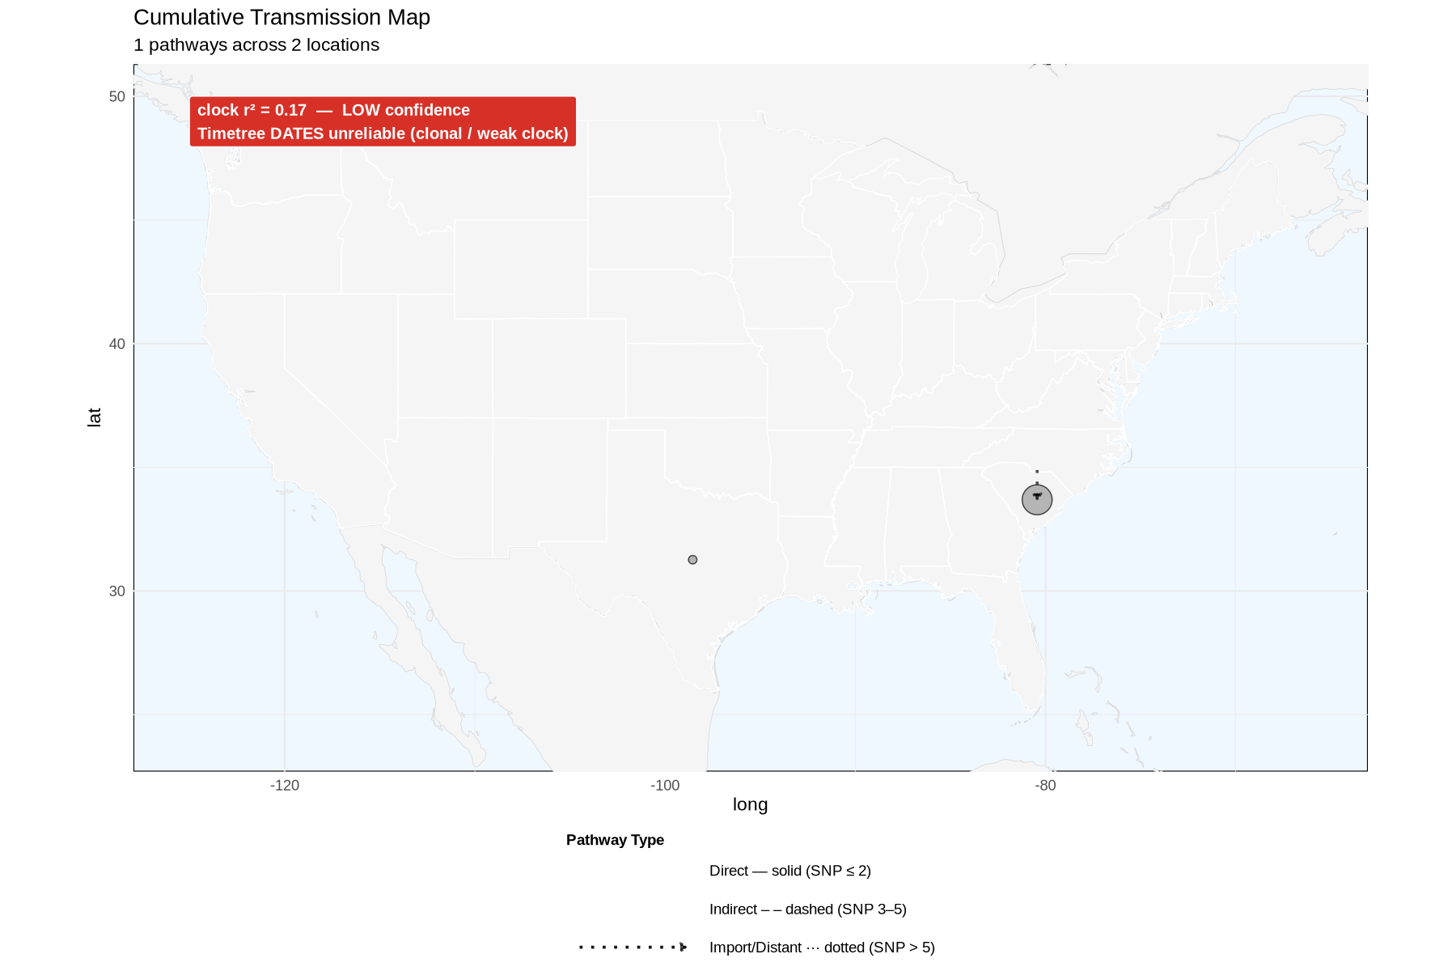
Texas vs South Carolina — two separate introductions
Breakdown: tx_sc · measles D8 · public PathoPlexus data
TREE (time-scaled)
MAP (transmission)
clock r² = 0.17 — LOW
• Two geographically distant 2025 introductions, little between them.
• Tree: two clean clumps that barely mix; map: two points, few/no arcs.
• This is 'no DETECTED transmission', not 'no transmission' — the design guarantees it.
• Clock has collapsed (r² 0.17) → do not quote the dates.

Slide 13
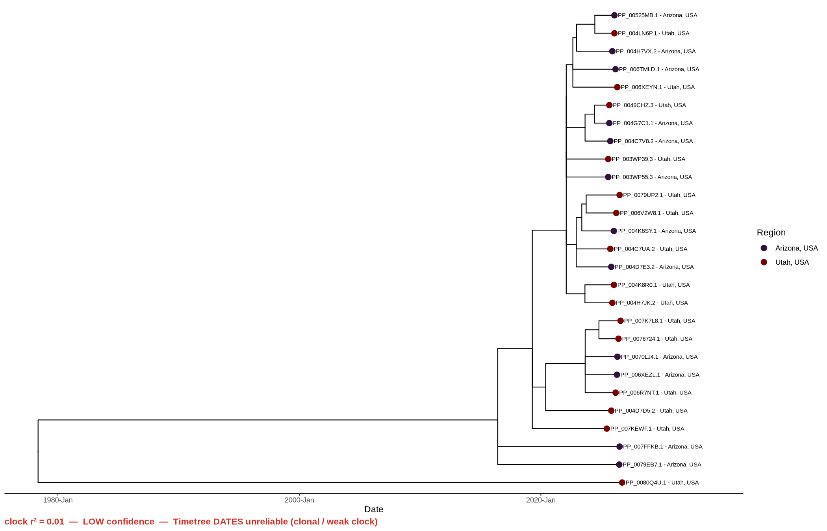
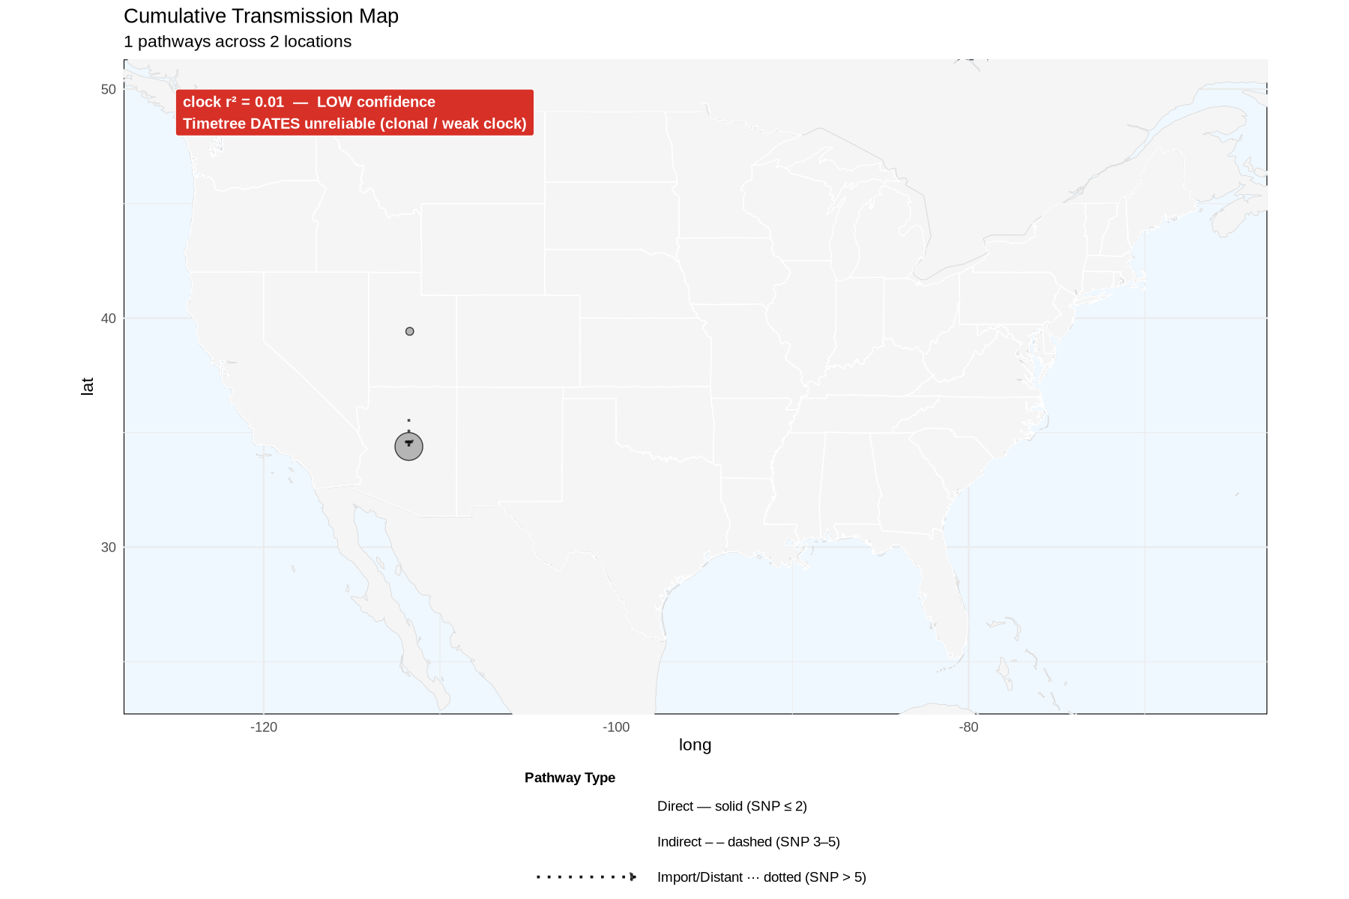
AZ ↔ UT (pruned) — why method matters, part 1
Breakdown: az_ut_reps · measles D8 · public PathoPlexus data
TREE (time-scaled)
MAP (transmission)
clock r² = 0.01 — LOW
• Arizona + Utah, aggressively thinned to representatives.
• The near-identical genomes get pruned away, so nothing is close enough to call 'direct'.
• Result: the map collapses to imports only — even between two states we know are linked.
• Clock r² 0.01: essentially clonal. Do not date it.

Slide 14
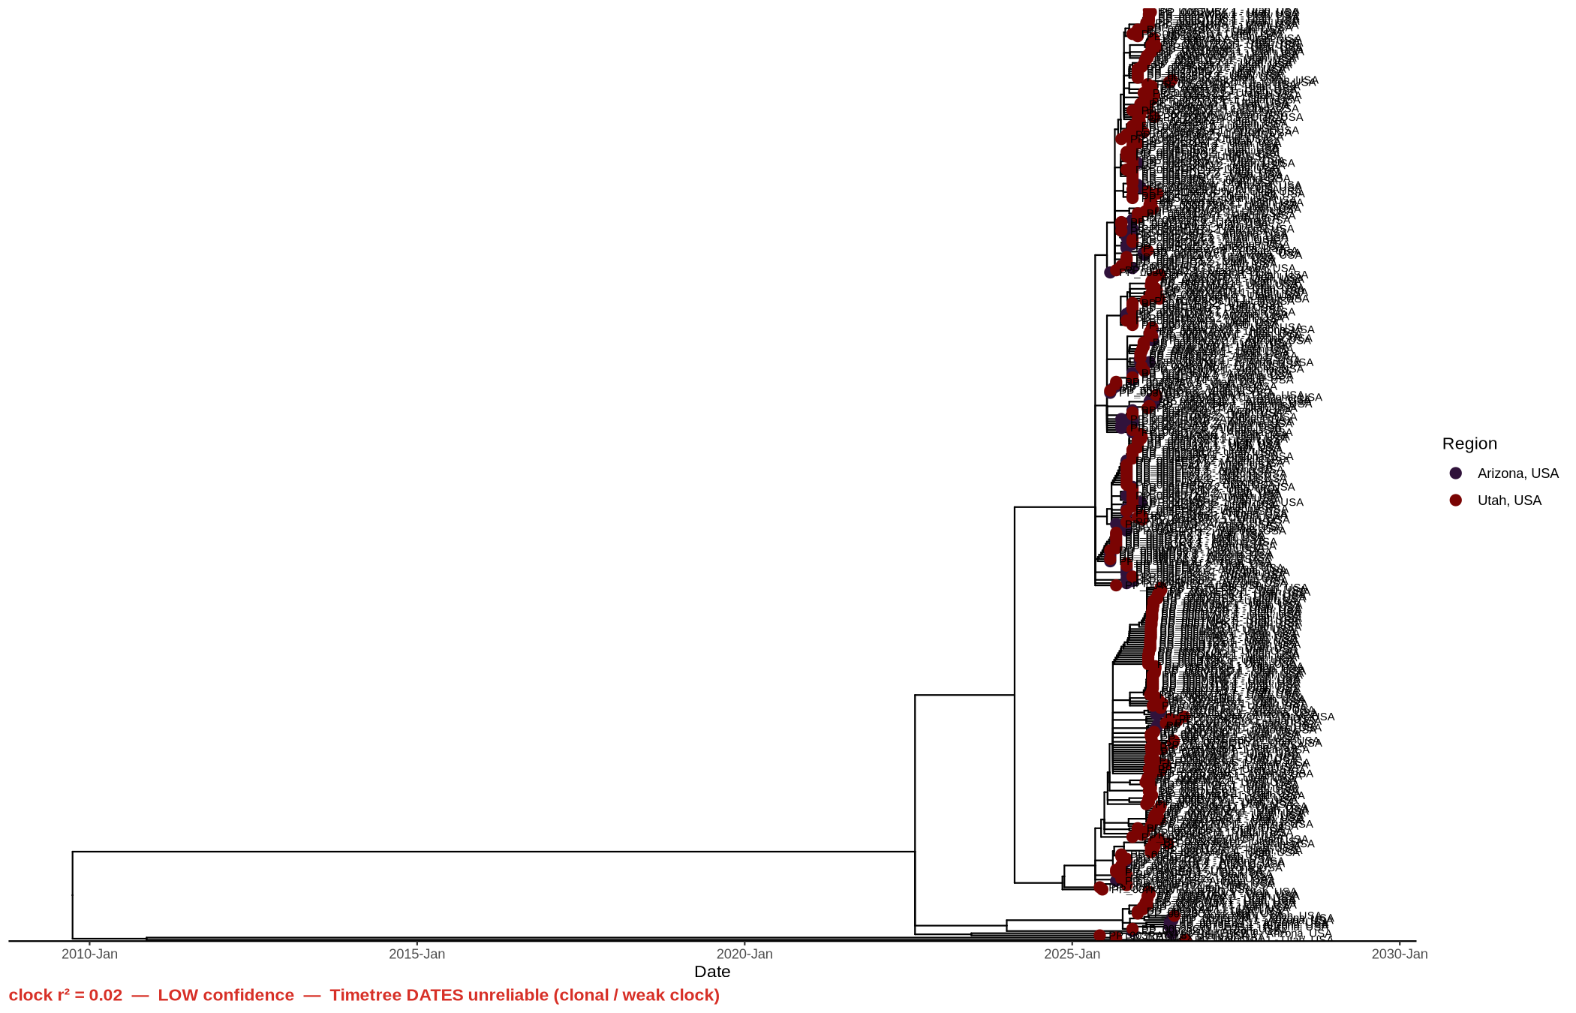
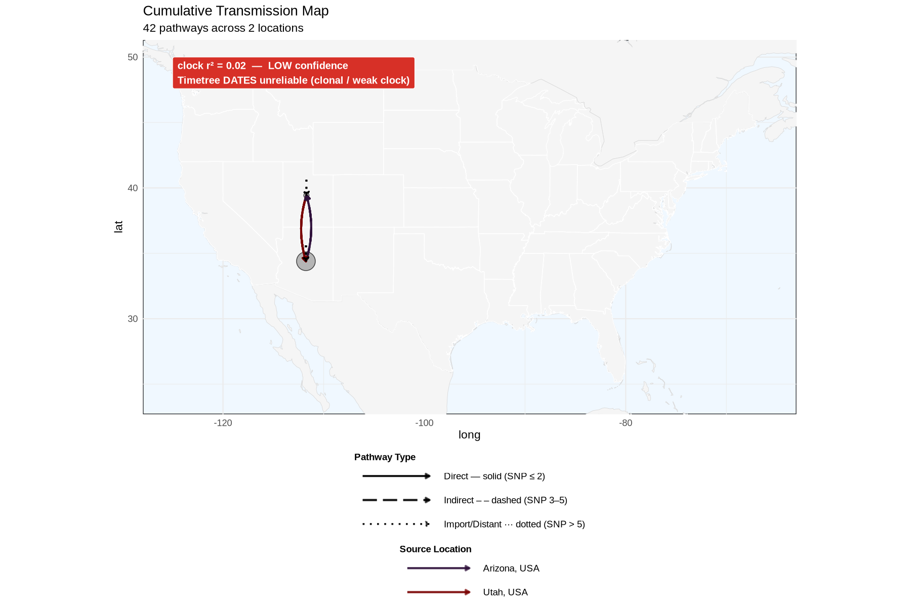
AZ ↔ UT (full variability) — why method matters, part 2
Breakdown: az_ut_dense · measles D8 · public PathoPlexus data
TREE (time-scaled)
MAP (transmission)
clock r² = 0.02 — LOW
• Same two states, full variability kept, no pruning.
• Now the near-identical genomes remain, so direct + indirect AZ↔UT links reappear.
• Lesson: aggressive pruning can erase real links. Keep variability when you want direct calls.
• Still only a two-location picture — more depth, not more geography. Clock still ~0.02.

Slide 15
What the maps are telling us
• Import vs direct
  – 'Direct' = genetically tight, plausible local transmission. 'Import' = closest sampled relative is far away.
• The surveillance gap
  – A map full of imports usually means we did not sequence the intermediate cases — not that the virus jumped far.
  – More representative sequencing helps, but it is a balance: piling on near-identical genomes can blur direct vs indirect.
• Pruning changes the answer
  – Over-pruning (az_ut_reps) manufactured an all-imports picture; keeping variability (az_ut_dense) recovered real links.
• Clock confidence first
  – Check r² before you read dates. Low r² (clonal data) → trust topology, not timing.

Slide 16
Conclusions we can draw
• We can watch a single D8 lineage expand over time on the dated tree.
• We can see state-to-state (and international) geographic spread signals on the map.
• We can rank how trustworthy the dates are per dataset using the clock r² badge.
• We can tell direct-ish links from imports via SNP thresholds — and most public-data links are imports.
• We can show that sampling and pruning choices change the result.
• The import-heavy picture makes the case for more, denser, more representative surveillance.

Slide 17
Limitations — keep these in view
• State-level only. No county/city — so we show state-to-state movement, not person-to-person chains.
• Clonal data / weak clock. D8 is recently expanded; several datasets have low r², so dates are often unreliable.
• Deep nodes are the least trustworthy part of a weak-clock tree — treat root/ancestor dates with caution.
• Mostly imports. Sparse public sampling makes maps import-heavy — a surveillance gap, not proof of long jumps.
• A strong clock does not prove direction. Even r² = 0.85 (international) can show odd directionality.
• We cannot correct for collection or submission bias in public data.

Slide 18
Read the inputs before you trust the picture.
The tree and map only know the samples you fed them.
'Import' usually means a sampling gap; a weak clock means the dates aren't trustworthy.
Code + data: github.com/ADHS-Taylor/phymapr · phymap-workflow · pathoplexus.org (OPEN)

